Slide 1
Red / Blue
Using Machine Learning to Build an
Ideologically Balanced News Diet
Salil Doshi
Sam Goodgame
Susan Eun Park
Paul Platzman
May 21st, 2016

Slide 2
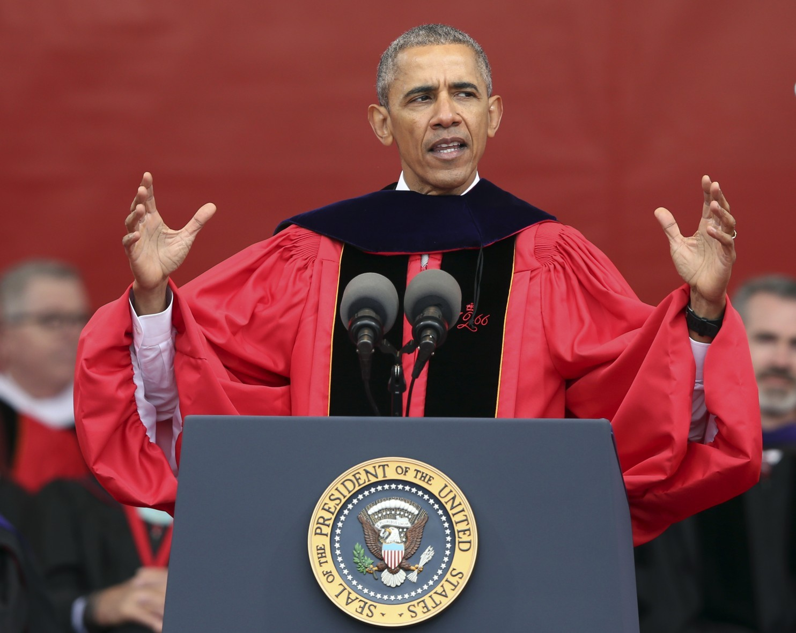
May 15th, 2016 -- Six Days Ago...
“...Today in every phone in one of your pockets we have access to more information than at any time in human history, at a touch of a button. But, ironically, the flood of information hasn’t made us more discerning of the truth. In some ways, it’s just made us more confident in our ignorance. We assume whatever is on the web must be true. We search for sites that just reinforce our own predispositions.”
-President Obama, Rutgers Commencement Address

Slide 3
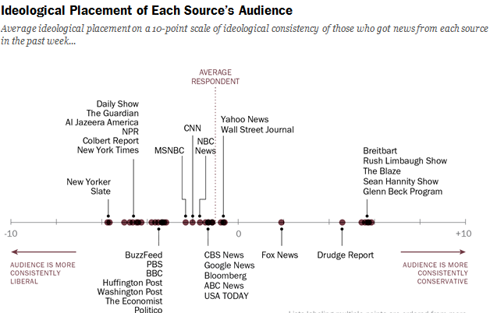
Pew Research Center
April 29, 2014

Slide 4
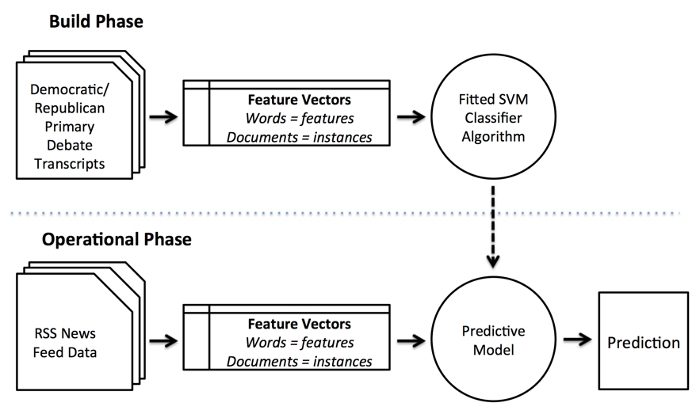
Architecture

Slide 5
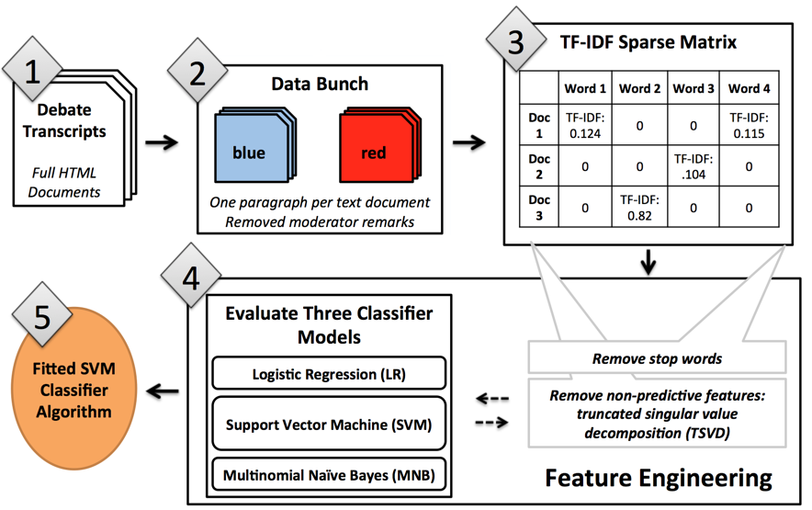
Build Phase

Slide 6

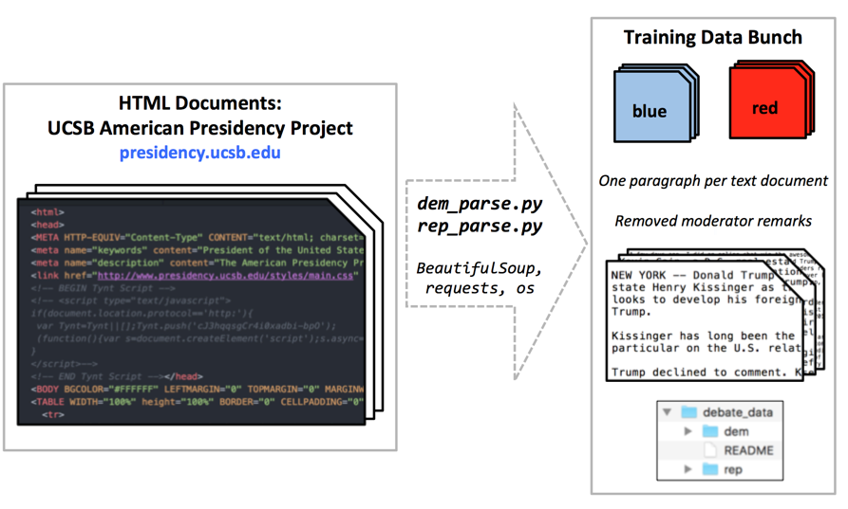

Training Data Ingestion and Wrangling

Slide 7

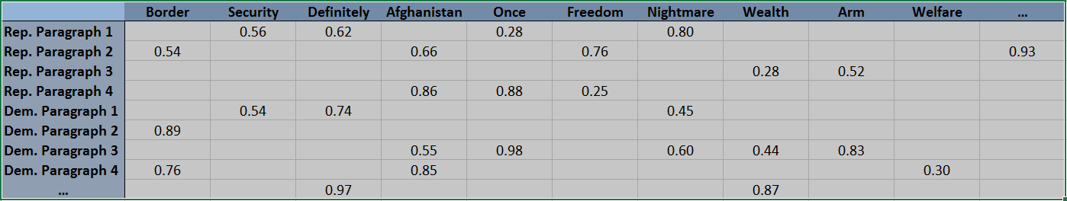
Data Transformation
Removed common English words and candidate and moderator names
Vectorized the Data
Computed Term Frequency-Inverse Document Frequency (TF-IDF) Values
Sample TF-IDF Vectorized Matrix:

Slide 8

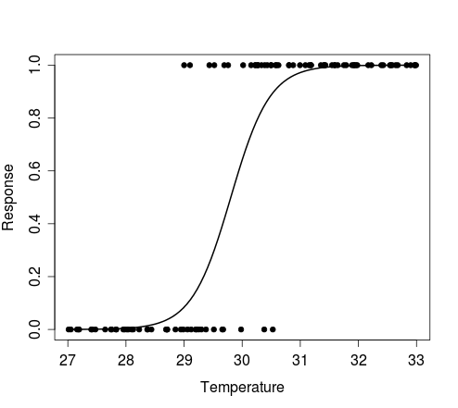
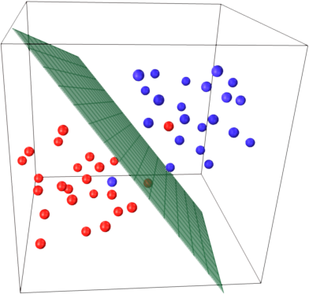
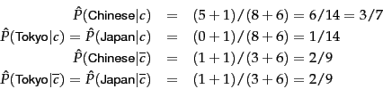
Model Estimators
Binary Classification Models:
Logistic Regression (LR)
Multinomial Naive Bayes (MNB)
Support Vector Machine (SVM)

Slide 9
Feature Engineering
Truncated Singular Value Decomposition (TSVD)
Reduced number of features without compromising predictive performance
11,228 features --> 2,000 features
No reduction in F-1 Score or Accuracy Score
Models with fewer than 2,000 features experienced diminished performance
Trend observed across each model form
SVM performed best overall and was chosen as final model form

Slide 10
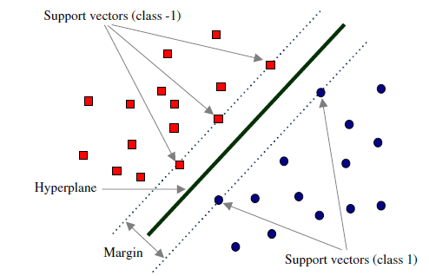
Parameter Tuning: Using Grid Search
Optimized ‘C’ Value, the penalty parameter
Maintained generalizability of model to prediction data
http://www.intechopen.com/source/html/45102/media/image44.png

Slide 11
SVM Model Performance Metrics
 | Precision | Recall | F-1 Score
Democratic | 0.76 | 0.58 | 0.66
Republican | 0.86 | 0.93 | 0.89
Average/Total | 0.83 | 0.84 | 0.83
Overall Accuracy Rate: 84%
Correct Democratic | Incorrect Democratic
n=392 | n=279
Correct Republican | Incorrect Republican
n=1693 | n=121

Slide 12
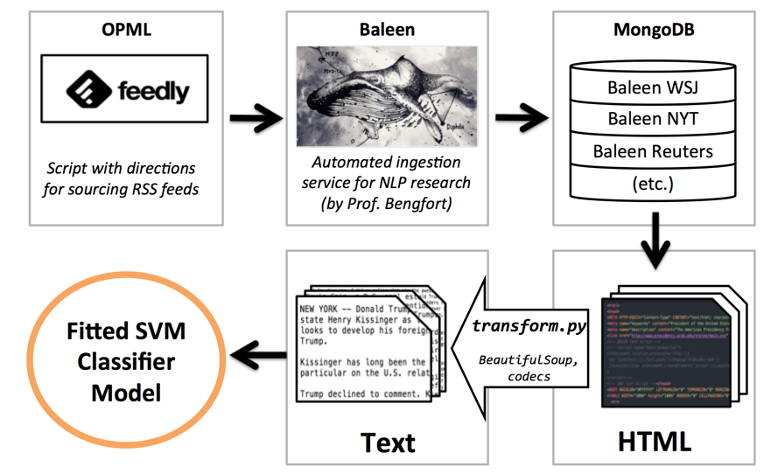
Operational Phase

Slide 13
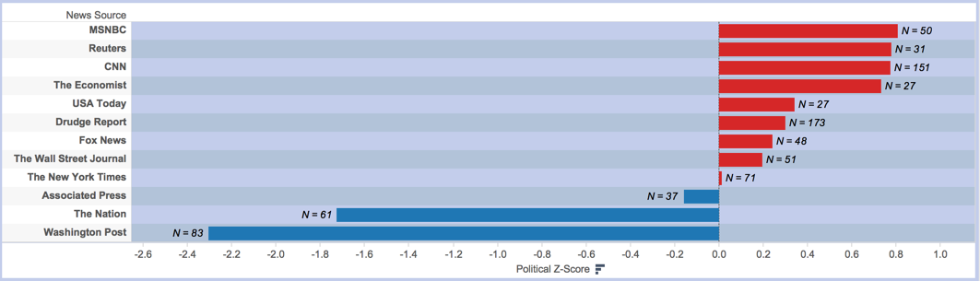
Prediction Results: Normalized Spectrum
79% of all documents were classified as Republican

Slide 14
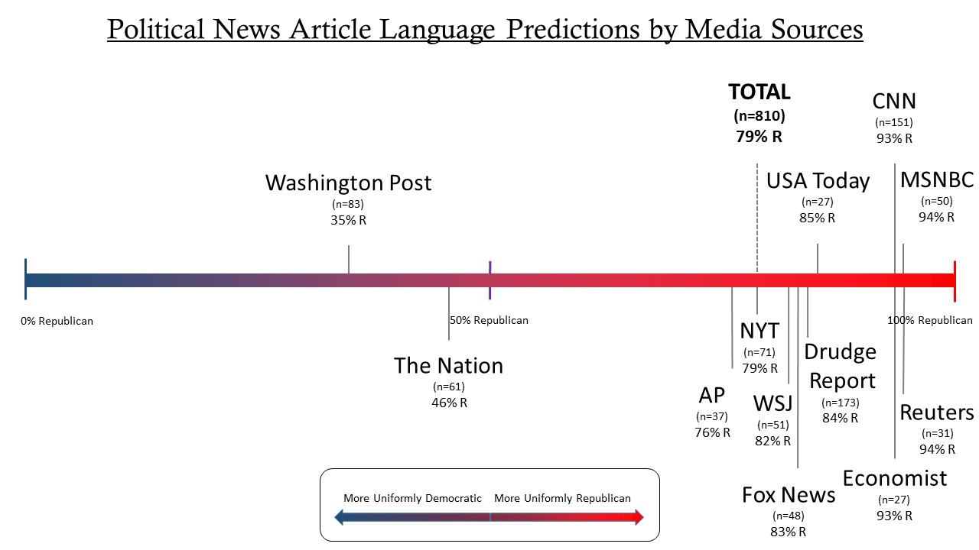
Prediction Results: Media Source Spectrum

Slide 15
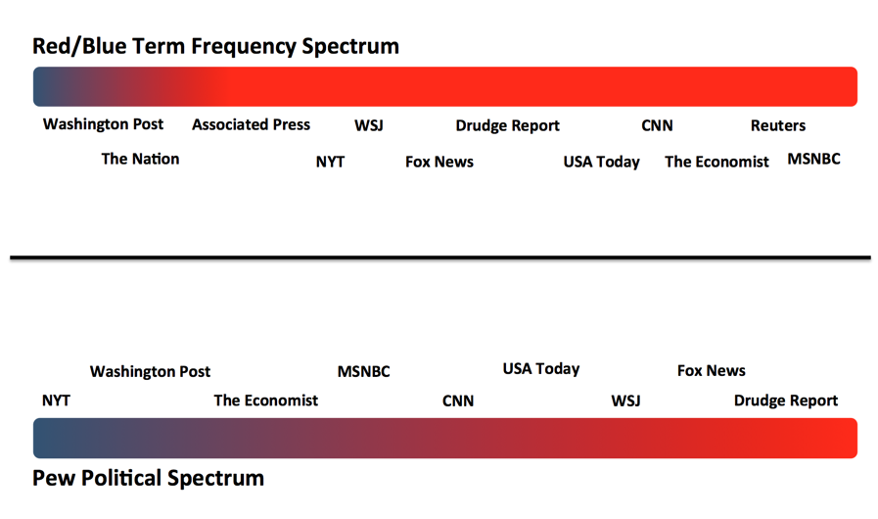
Prediction Results vs. Pew Research Center Results

Slide 16
Discussion
Results don’t match ideological spectrum of audiences. Several potential interpretations:
Republican stories dominated news cycles
Republican candidates more regularly used pre-existing media language
Oral language is not strongly predictive of written language

Slide 17
Methodological Self-Evaluation (1)
Strengths:
Expansion of instance set to reduce model performance variation
Removal of moderator speech
Removal of custom stop words
Employed a variety of model forms
Reduced feature set size without impeding performance
Optimized ‘C’ parameter value

Slide 18
Methodological Self-Evaluation (2)
Shortcomings:
RSS feed content was not always ideal or consistent
Contained ‘jQuery’ or advertisement placeholders
Variety in article length
Variable number of instances from each media outlet
Single source of training data
Uneven distribution of red/blue training data

Slide 19
Looking Towards Future Iterations
Future studies could…
Use additional training data sources
Encompass prediction data of greater breadth and depth: more news sources and more articles per source
Include more feature engineering to account for differently formatted RSS feeds
Predict oral political dialogue

Slide 20
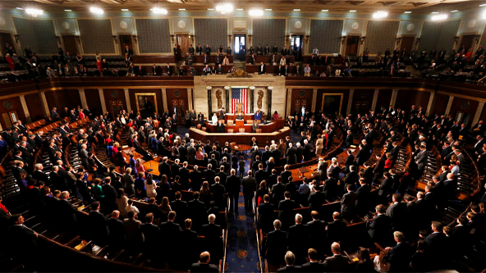
For Posterity
Implications for partisanship...
The potential virtue of an ideologically balanced diet
A shift in media engagement behaviors could promote open-mindedness and compromise
This, in turn, could promote legislative functioning

Slide 21
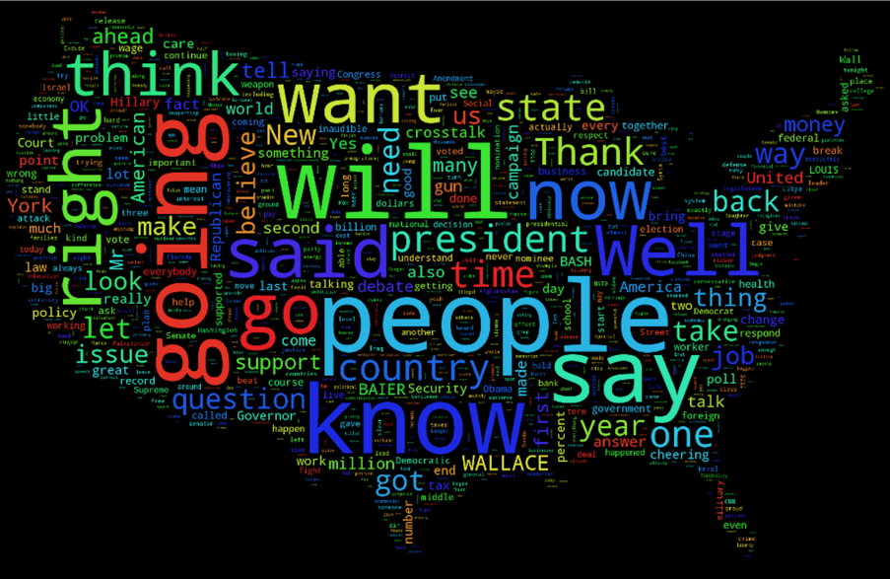
Questions?

